Slide 1
Storytelling with Data
Mike Purtell

Slide 2
My Speech is Ready
Strong opening
Well organized
Filler words gone
Coherent message
Good close
What about the Slides

Slide 3
Visual analog of Toastmaster’s filler words
Chart Junk – coined by Edward Tufte in his 1983 book, ‘The Visual Display of Qualitative Information’
Chart junk adds ink, without adding value
Examples are graph borders, gridlines, over-precise numbers, lengthy category names, awkward legends and so much more.

Slide 4
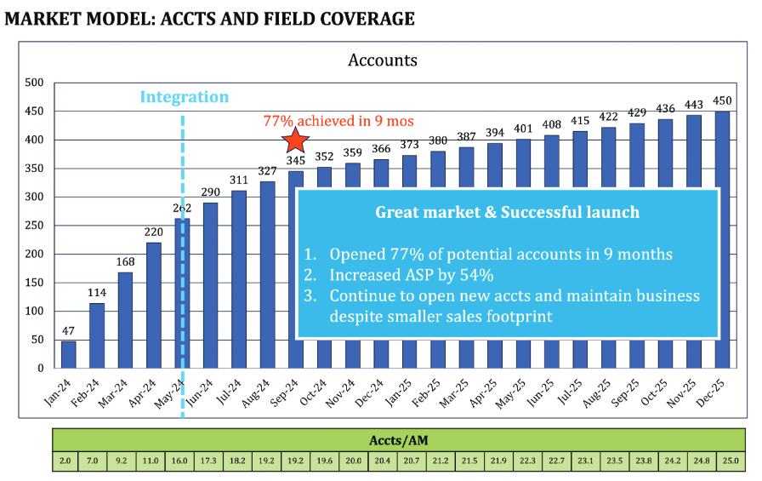
Here is an example
Border
Gridlines
Purpose or Message
Delineation of past data and future projections
Dual messages
Data buried in tables
This Image is from “Storytelling with Data Before and After, 2025
Notes:
Spell out specialized language – Accts/AM
Differential between past and future
Don’t let important data be hidden in tables, like this example with Accts/AM (Accounts per Account Manager)
Pressure test your assumptions – especially important when forcasting
Define the story – success or call to action
Redundant y-axis values and data labels
Horizontal grid lines
Time to so what

Slide 5
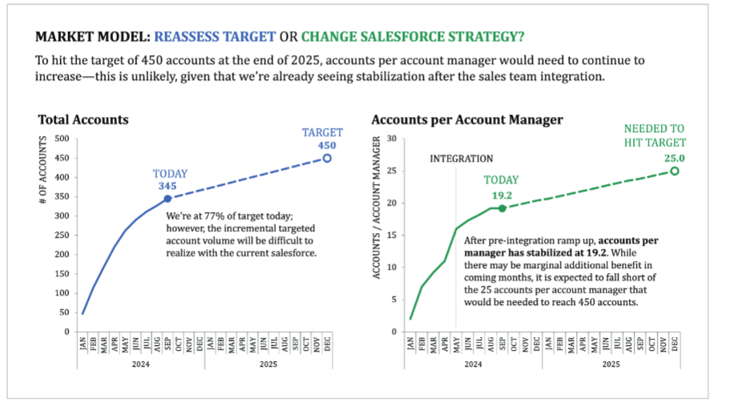
Here is an remake of previous slide
Takeaway title
Sensible colors
Purpose or Message
Past vs. Future, hard to tell
This Image is from “Storytelling with Data Before and After, 2025

Slide 6
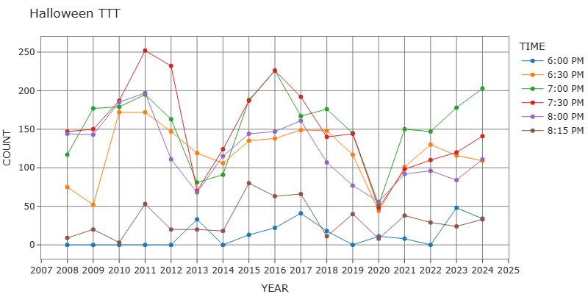
What the heck is TTT?

Slide 7
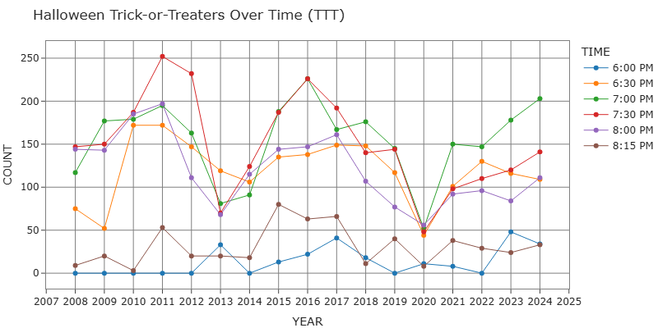
Smooth out the line shapes

Slide 8
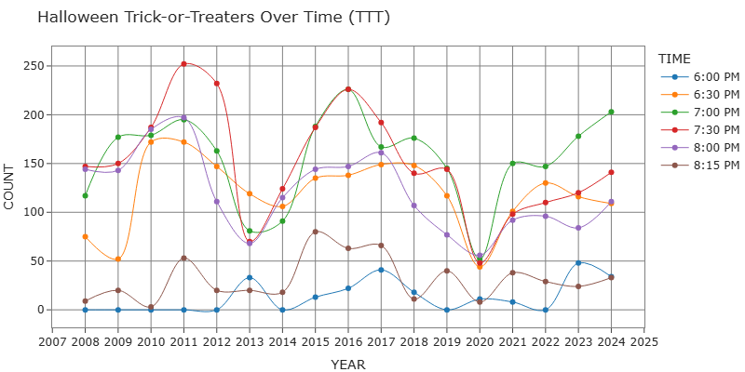
Lose the gridlines

Slide 9
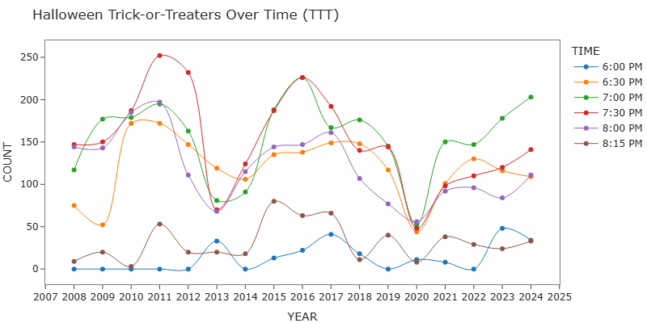
Get rid of the top and right-side borders

Slide 10
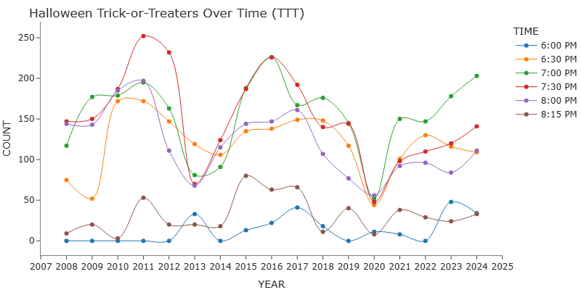
Remove axis label ‘Year’ – it’s obvious

Slide 11
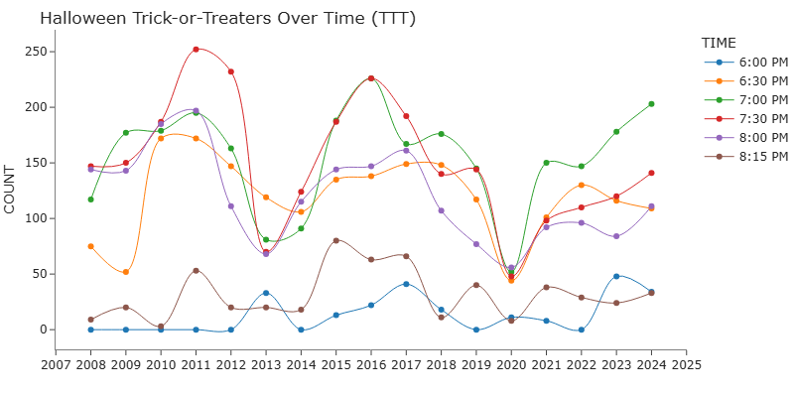
Space out the year labels, to every 2 or 3

Slide 12
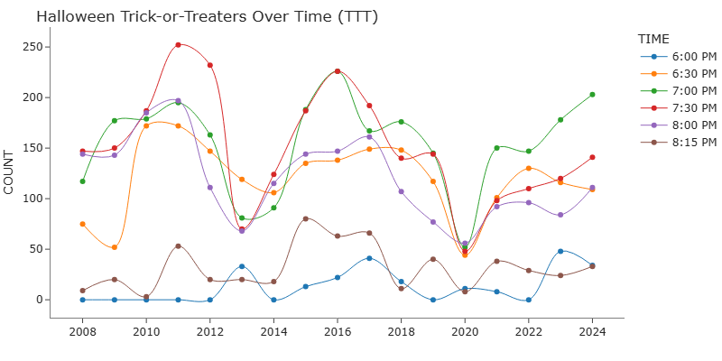
Get rid of the legend

Slide 13
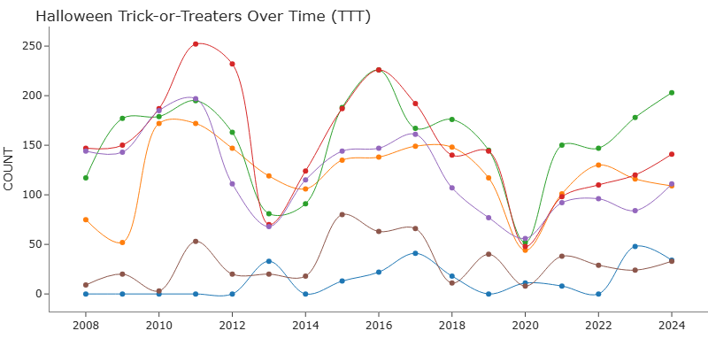
Add trace labels

Slide 14
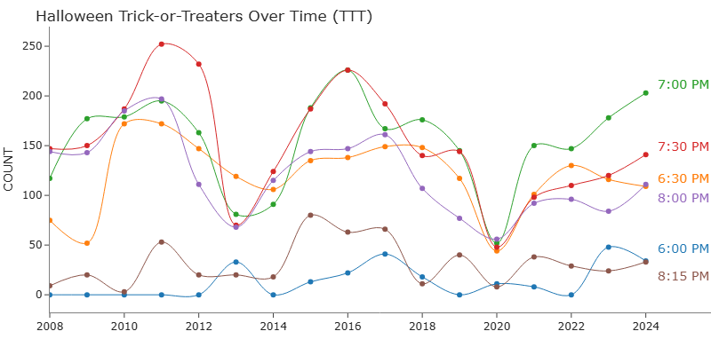
What happened in 2020?

Slide 15
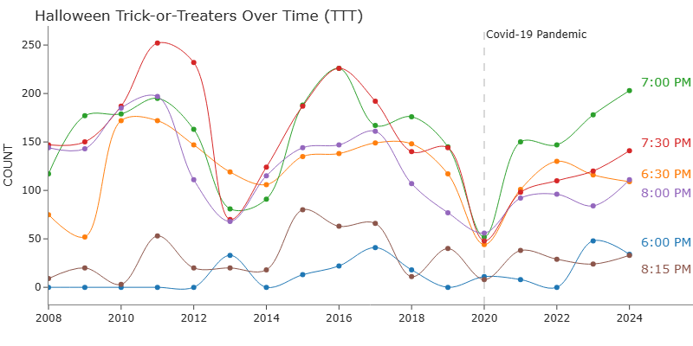
I don’t care about the time of day. I need to figure out how much candy to have on hand

Slide 16
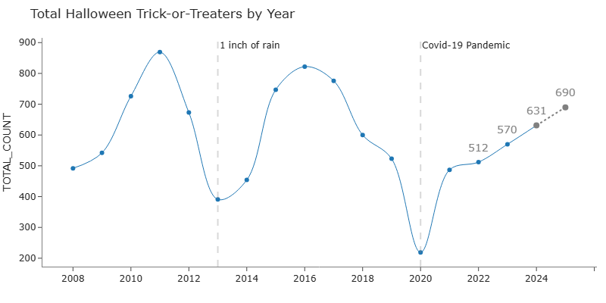
Looking better – but Halloween this year is on a Friday, should I buy extra candy?

Slide 17
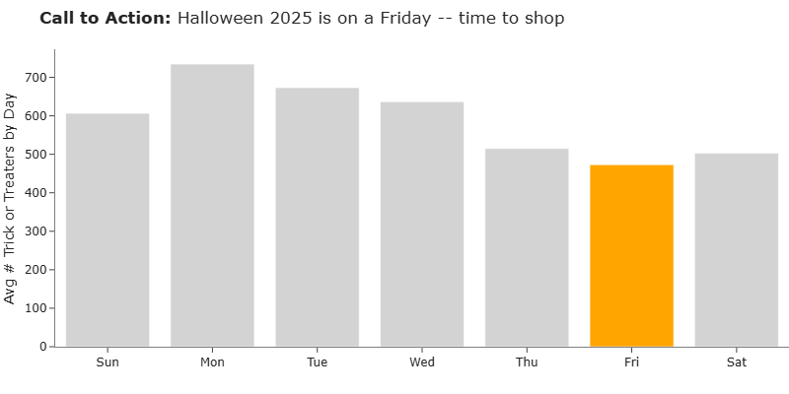
My assumptions were wrong – Fridays are less busy than all other days- who knew?

Slide 18

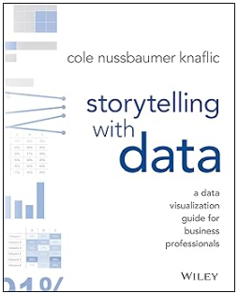



Inspiration, move me brightly
2015
September 2025
https://youtu.be/8EMW7io4rSI?si=ESwsYe157mw2-7MO

